Slide 1

Analyzing Green Taxi Trends in NYC
Team 7: Chamnan, Allison, Anna, Akhil, and Mudongfang
Notes:
Good morning everyone! We’re team 7 and today we are going to walk you through New York City Green Taxis analysis.

Slide 2
Table of contents
01
02
03
04
05
06
Introduction
Data Prepping & Cleaning
Exploratory Questions
Data Visualizations on Tableau
Our Project Findings
Recommendations & Limitations
Notes:
Here is the outline of today’s presentation. We will start introduction and finish with recommendations and limitations.

Slide 3
01
Introduction

Slide 4

Problem Statement
As NYC green taxis are gradually being phased out, ridership has declined, impacting revenue and overall urban mobility. By analyzing NYC green taxi ridership and trip characteristics, we can see how COVID-19 reshaped travel patterns and mobility across neighborhoods.
This project examines…
Rider behavior over time
Revenue trends over time
The impact of COVID
Goal: To inform planning and decision-making for drivers and city officials
Notes:
NYC Green taxis was launched in 2013 with the purpose to serve areas that Yellow Taxis rarely cover. As they are gradually being phased out, we witness the decrease of trips volume, resulting in impact on revenue and overall urban mobility. Our project aims to analyze Green taxis ridership and trip characteristics, so we could better understand how major factors such as phased reduction and COVID-19 influenced travel patterns and mobility across neighborhoods, such as Manhattan, Brooklyn, Queens and so on.

Slide 5
Data Preparation
& Cleaning
02

Slide 6
Data Source Information + Cleaning
Data Sources
Data Cleaning Steps
Pre-processing before analysis
Dropped unused columns
Removed duplicate rows
Replaced missing values using mode
Combined datasets (UNION DISTINCT)
Renamed unified table to all_trip_records
NYC OpenData – Green Taxi Trip Records
Six datasets and data dictionaries
Annual trip records (2019–2023)
Pickup_dropoff_monthly.csv
Two sets of data dictionaries
Notes:
Let’s first dive into our data. We obtained six datasets from New York City Open Data website. Our first five datasets cover trip records between 2019 and 2023 and our last dataset represents monthly pickup-dropoff trip data. We also downloaded two sets of data dictionaries to better understand each column in the datasets.
Next, we perform data cleaning; we dropped empty columns, removed duplicate rows, and replaced missing values with mode. After that we used UNION DISTINCT operator to combined our five years cleaned datasets into one table and made them ready for our analysis.

Slide 7
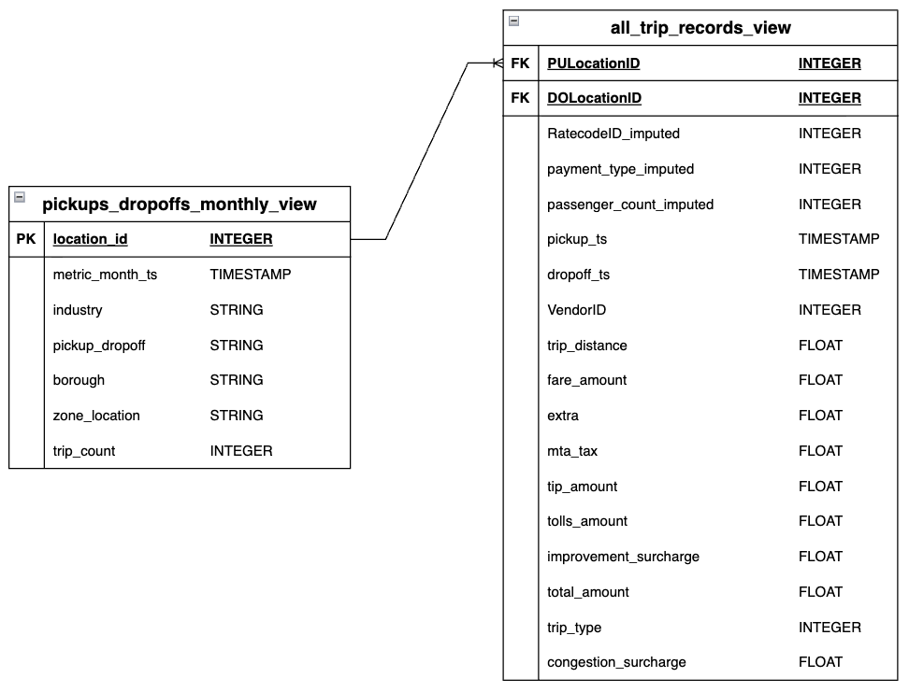
Entity Relationship Diagram
Notes:
And here is our ER diagram of the cleaned dataset. As you can see use one to many relationship because one record in monthly pickup-dropoff table can have one to many records in trip records table. Now our data is ready and I will hand it over to Anna.

Slide 8
03
Exploratory Questions

Slide 9
Initial Questions
Rider Behaviors
Revenue-Related Findings
Number of Trips, Durations, & Trips by Borough Inform:
Overall Green Taxi usage
Ridership peaks/dips
Transportation demand patterns by borough
Revenue, Payment, & Congestion Surcharges Inform:
Payment method preferences over time
Impact of surcharges on fare composition
Earning projections for taxi drivers
Is There a COVID Impact?
Comparing Pre-COVID, During, & Post-COVID Shows:
How rider behavior has been impacted
How revenue has been impacted
Short vs longer-term COVID repercussions
Notes:
Anna- we chose some SQL exploratory questions which also informed our Tableau visualizations.

Slide 10
Tableau Data Visualizations
04
Riders Behavior Overview Tableau Public Link
Revenue Overview Tableau Public Link
Notes:
Allison
For the presentation, use Desktop

Slide 11
05
Our Project Findings

Slide 12
Conclusion
01
Ridership declined sharply over time
Weekday afternoons and Thu/Fri had the highest demand; Sundays the lowest
Temporal Trends
Manhattan consistently had the highest pickups
Staten Island showed more costly trips, likely driven by high trip duration
02
Geographic Patterns
03
Rider Behaviors
Cashless payments rose significantly post-COVID
Trip distance and borough differences shaped cost and tipping patterns
Why we care:
Optimize our current green taxi operations
Provide insights as green taxis potentially merge into other taxi services/rideshare platforms
Notes:
Mudongfang

Slide 13
Recommendations & Limitations
06

Slide 14
Recommendations For Stakeholders:
Government officials:
Expand digital fare systems
Review regulations amid ridership decline
Taxi Drivers:
Focus on peak periods
Consider shifting to rideshare or pre-arranged due to phase-out
City planners:
Optimize stand locations based on demand
Allocate more resources to Manhattan/Queens
Support low-access areas
Notes:
Akhil
Note：NYC’s congestion surcharge is mandated by policy, and the fee goes to the MTA rather than to taxi drivers.

Slide 15
Project Limitations
Limited Representation
Green taxis account for a small & declining share of NYC trips, limiting city-wide generalizability
Data Quality Issues
Some trips include missing data and likely inaccurate earning reports (like no cash tips reported)
Geographic Instability
Low trip volumes in some zones (like Staten Island) reduce reliability of zone-level averages
Notes:
Akhil

Slide 16
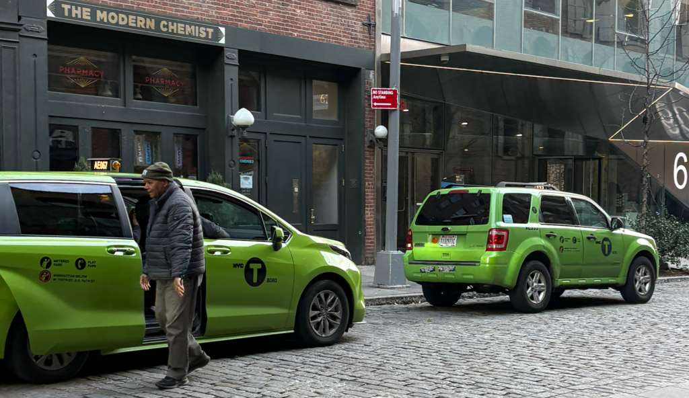
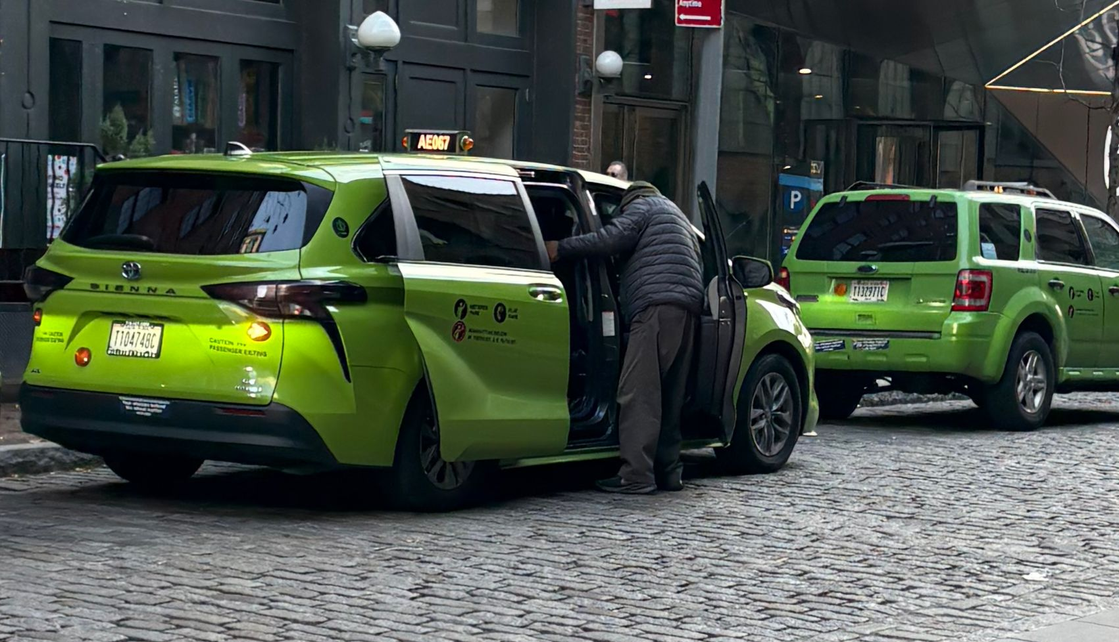
Thank you!
Photo: Akhil’s Business Trip
Any questions?
Photo: Akhil’s Business Trip
Team7: Chamnan, Allison, Anna, Akhil, and Mudongfang
Notes:
Good morning everyone! We’re team 7 and I’m Chamnan (each member present their name) and today we are going to walk you through New York City Green Taxis analysis.

